Slide 1
Unit-2

Slide 2
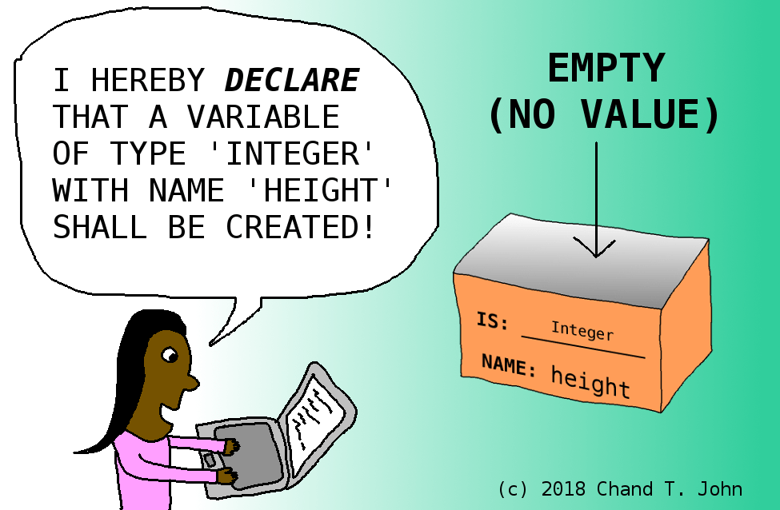
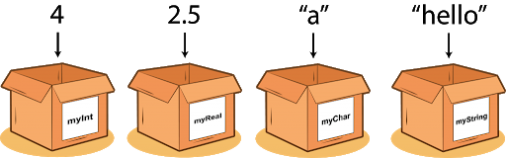
VALUES AND DATA TYPES

Slide 3
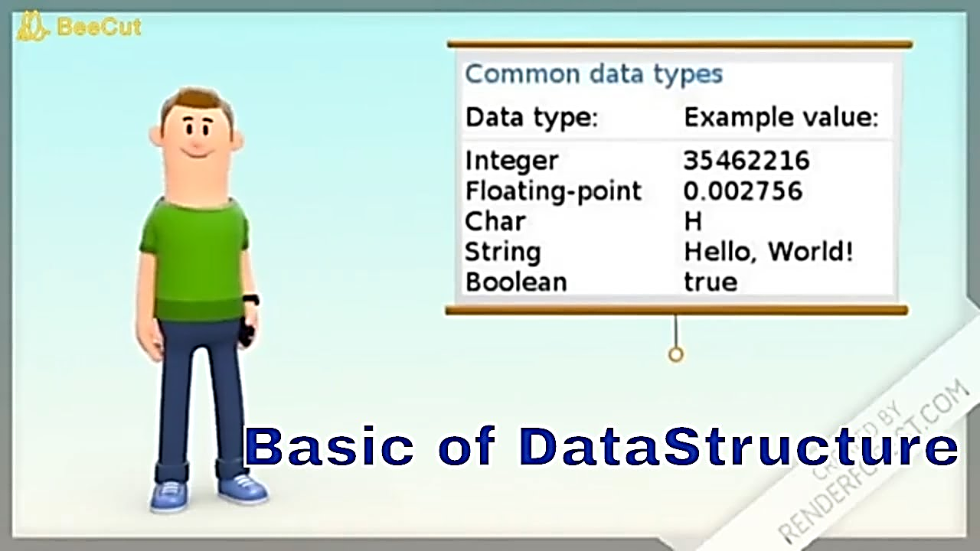
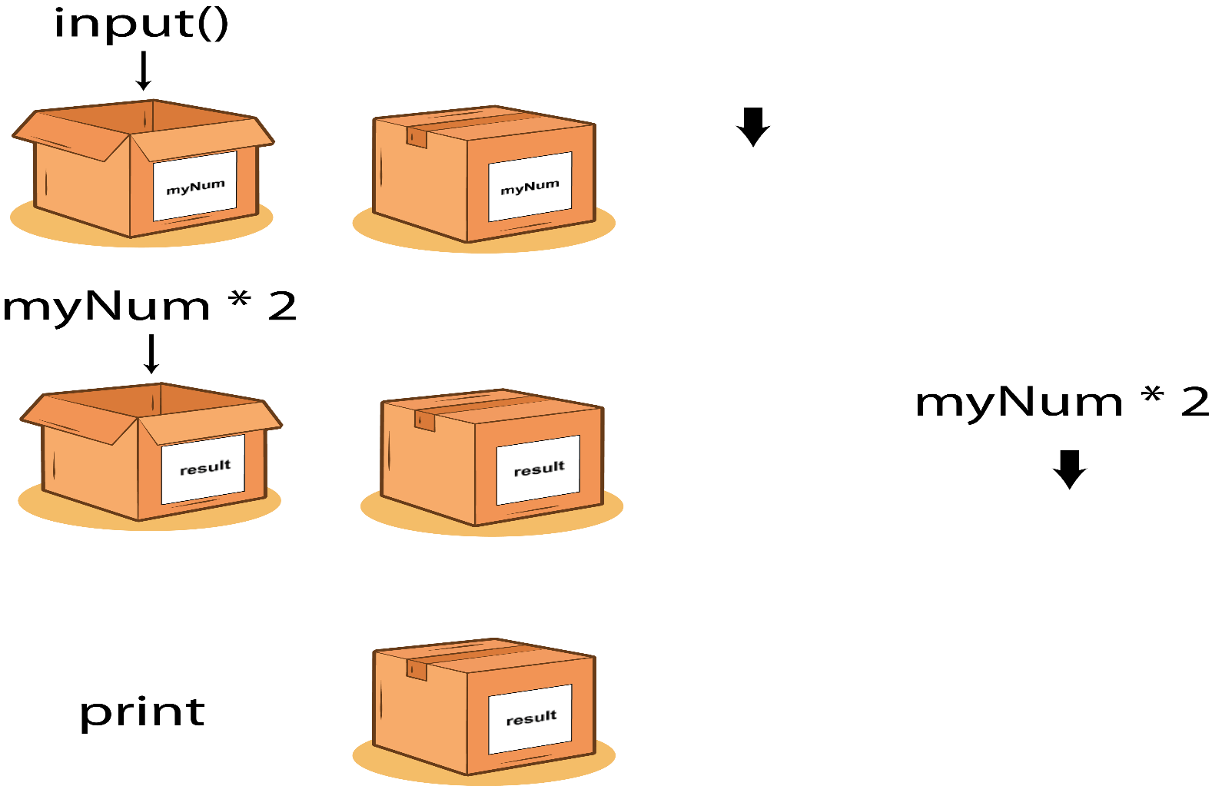
VALUES AND DATA TYPES

Slide 4
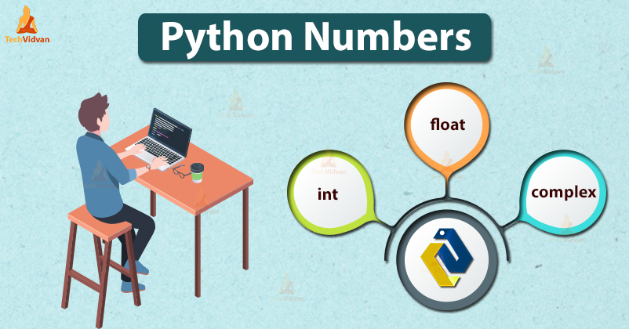
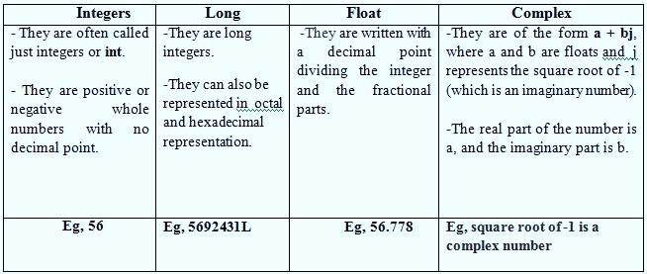
NUMBERS
Number data type stores Numerical Values.
This data type is immutable [i.e. values/items cannot be changed].
Python supports integers, floating point numbers and complex numbers. They are defined as,

Slide 5
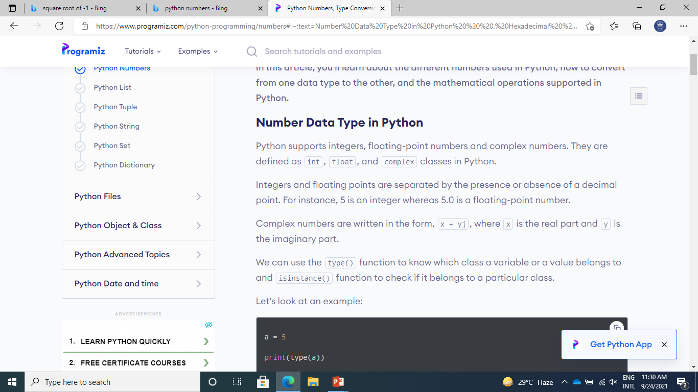

Slide 6
SEQUENCE
A sequence is an ordered collection of items, indexed by positive integers.
It is a combination of mutable (value can be changed) and immutable (values cannot be changed) data types.
There are three types of sequence data type available in Python, they are
Strings
Lists
Tuples

Slide 7
STRINGS
A String in Python consists of a series or sequence of characters - letters, numbers, and special characters.
Strings are marked by quotes:
• single quotes (' '), Eg, 'This a string in single quotes'
double quotes (" "), Eg, "This a string in double quotes“
triple quotes (""“ """), Eg, This is a paragraph. It is made up of multiple lines and sentences."""
Individual character in a string is accessed using a subscript (index).
Characters can be accessed using indexing and slicing operations
Strings are immutable i.e. the contents of the string cannot be changed after it is created.

Slide 8
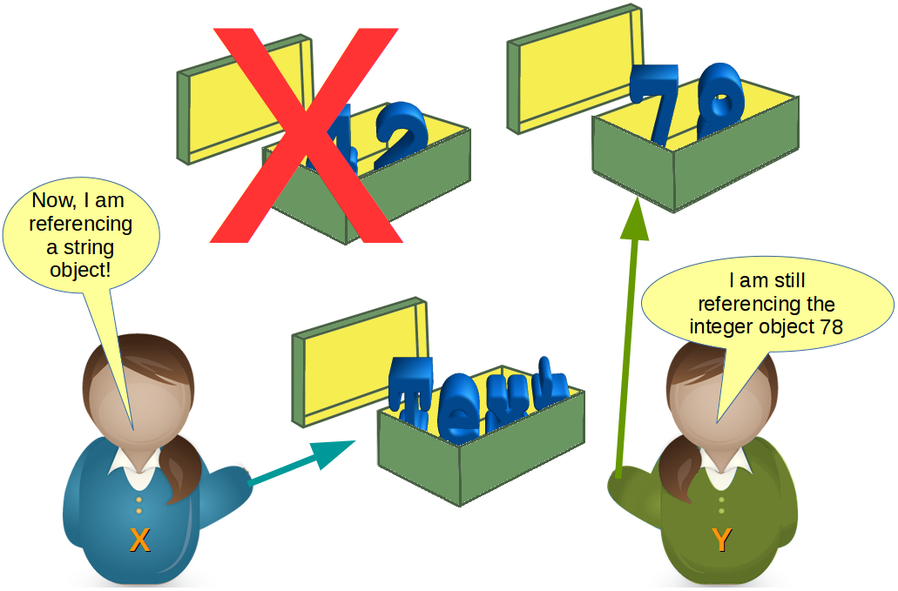
STRINGS
Strings and Operations
Indexing
Concatenation
Slicing
Repetition
Membership
Live Examples …….

Slide 9
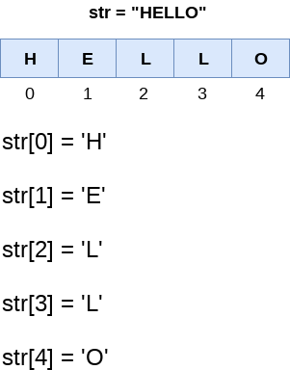

Slide 10
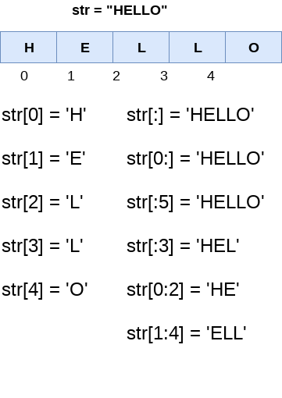

Slide 11
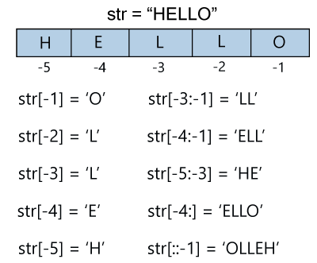

Slide 12
LISTS
A list in Python is used to store the sequence of various types of data.
L1 = ["John", 102, "USA"]
L2 = [1, 2, 3, 4, 5, 6]
The items in the list are separated with the comma (,) and enclosed with the square brackets [].
Python lists are mutable type it means that we can modify its element after it created.
However, Python consists of six data-types
They are capable to store the sequences.
But the most common and reliable type is the list.

Slide 13
print(type(L1))
print(type(L2))
<class ‘list’>

Slide 14
Characteristics of Lists
The lists are ordered.
a = [1,2,"Peter",4.50,"Ricky",5,6]
b = [1,2,5,"Peter",4.50,"Ricky",6]
a ==b This results in False. Why?
The element of the list can access by index.
The lists are the mutable type.
A list can store the number of various elements.

Slide 15
LISTS
Lists and Operations
Indexing
Concatenation
Slicing
Repetition
Membership
Updation-Deletion and Insertion
Live Examples …….

Slide 16
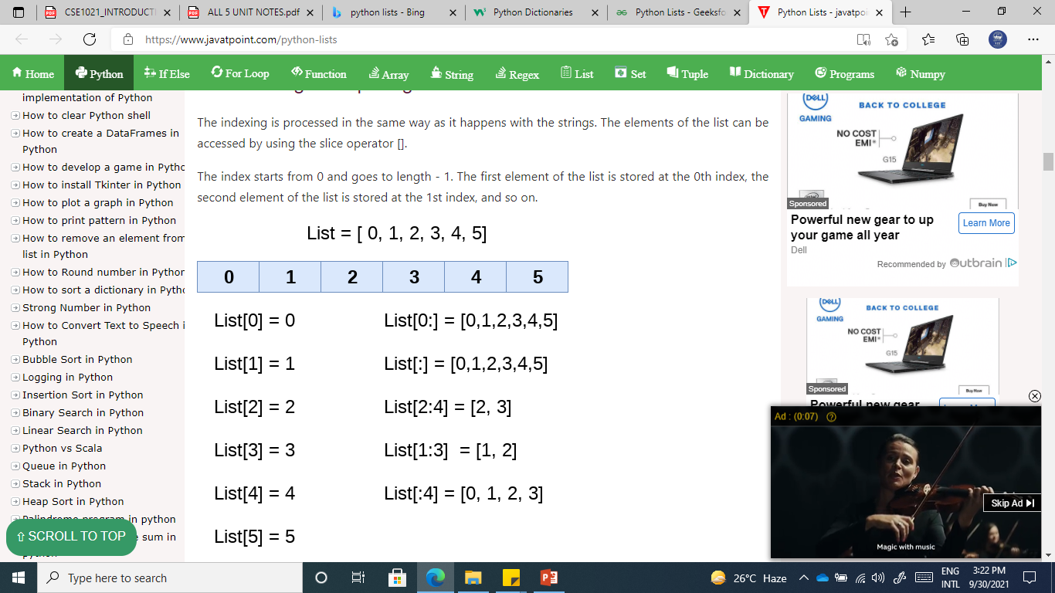

Slide 17
list_varible(start:stop:step)
The start denotes the starting index position of the list.
The stop denotes the last index position of the list.
The step is used to skip the nth element within a start:stop

Slide 18
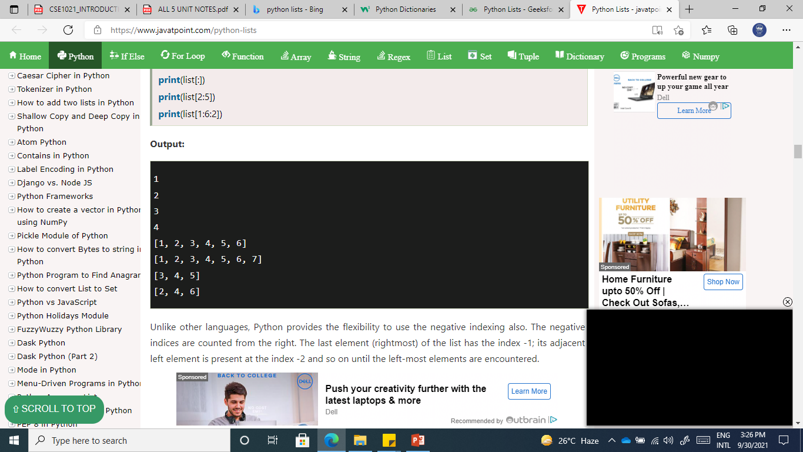
list = [1,2,3,4,5,6,7]
print(list[0])
print(list[1])
print(list[2])
print(list[3])
# Slicing the elements
print(list[0:6])
print(list[:])
print(list[2:5])
print(list[1:6:2])

Slide 19
Unlike other languages, Python provides the flexibility to use the negative indexing also.
The negative indices are counted from the right.
The last element (rightmost) of the list has the index -1;
its adjacent left element is present at the index -2 and so on until the left-most elements are encountered.

Slide 20
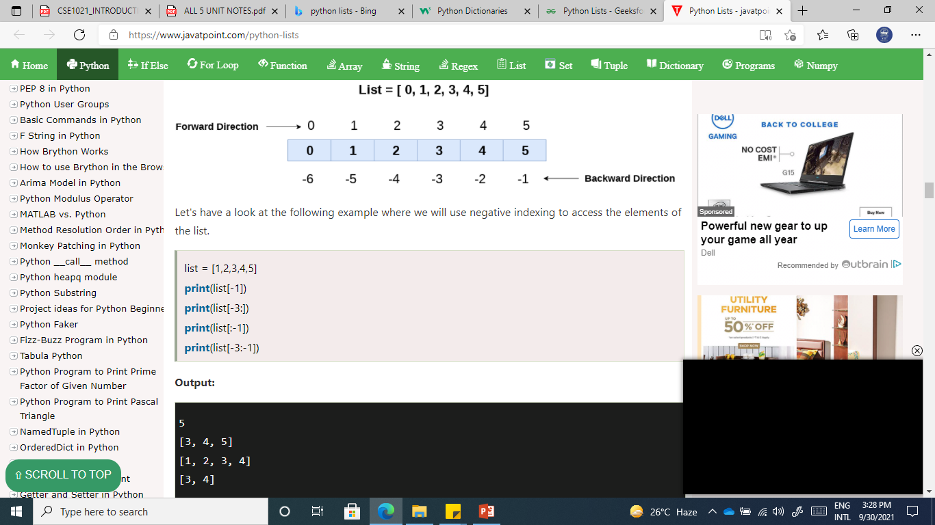

Slide 21
Updating List values
Lists are the most versatile data structures in Python since they are mutable, and their values can be updated by using the slice and assignment operator.
list = [1, 2, 3, 4, 5, 6]
print(list)
list[2] = 10
print(list)
list[1:3] = [89, 78]
print(list)
list[-1] = 25
print(list)
[1, 2, 3, 4, 5, 6]
[1, 2, 10, 4, 5, 6]
[1, 89, 78, 4, 5, 6]
[1, 89, 78, 4, 5, 25]

Slide 22
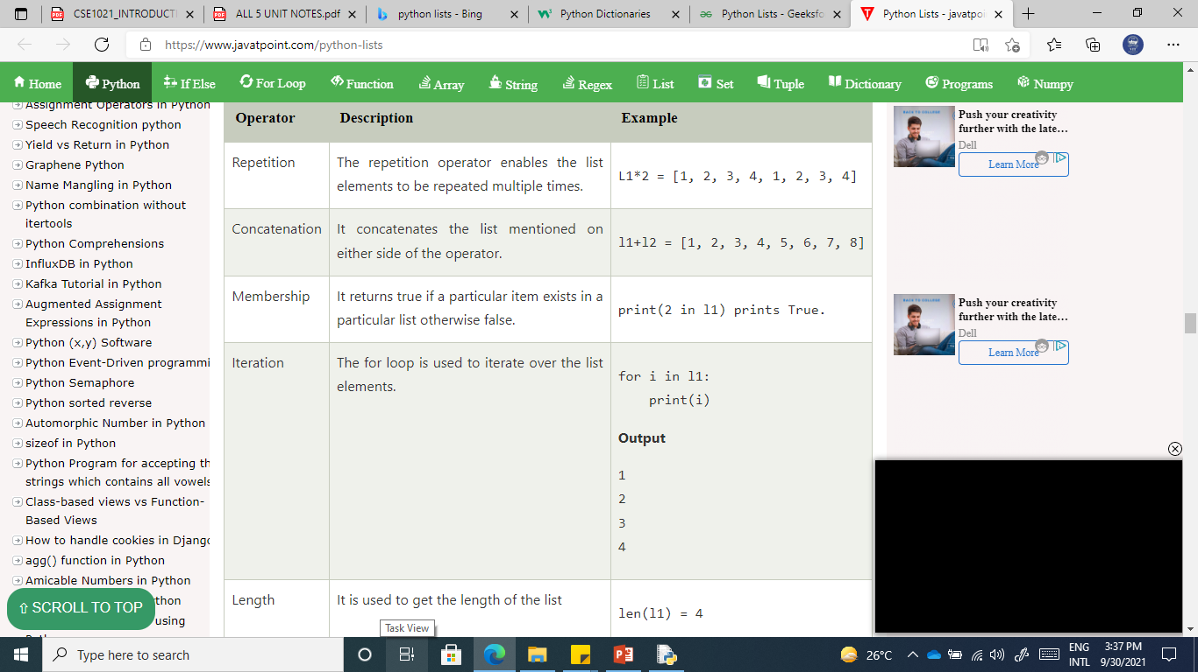
l1 = [1, 2, 3, 4] l2 = [5, 6, 7, 8]

Slide 23
TUPLES
A tuple is same as list, except that the set of elements is enclosed in parentheses instead of square brackets.
Tuple is an immutable list. i.e. once a tuple has been created, you can't add elements to a tuple or remove elements from the tuple.
Benefit of Tuple:
Tuples are faster than lists.
If the user wants to protect the data from accidental changes, tuple can be used.
Tuples can be used as keys in dictionaries, while lists can't.

Slide 24
TUPLES
Tuples and Operations
Indexing
Concatenation
Slicing
Repetition
Live Examples …….

Slide 25
T1 = (101, "Peter", 22)
T2 = ("Apple", "Banana", "Orange")
T3 = 10,20,30,40,50
print(type(T1))
print(type(T2))
print(type(T3))
<class 'tuple'>
<class 'tuple'>
<class 'tuple'>

Slide 26
Empty Tuple
T4 = ()
Creating a tuple with single element is slightly different. We will need to put comma after the element to declare the tuple.
tup1 = ("JavaTpoint")
print(type(tup1))
#Creating a tuple with single element
tup2 = ("JavaTpoint",)
print(type(tup2))
<class 'str'>
<class 'tuple'>

Slide 27
tuple1 = (10, 20, 30, 40, 50, 60)
print(tuple1)
count = 0
for i in tuple1:
print("tuple1[%d] = %d"%(count, i))
count = count+1
(10, 20, 30, 40, 50, 60)
tuple1[0] = 10
tuple1[1] = 20
tuple1[2] = 30
tuple1[3] = 40
tuple1[4] = 50
tuple1[5] = 60

Slide 28
tuple1 = tuple(input("Enter the tuple elements ..."))
print(tuple1)
count = 0
for i in tuple1:
print("tuple1[%d] = %s"%(count, i))
count = count+1
Enter the tuple elements ...
123456
('1', '2', '3', '4', '5', '6')
tuple1[0] = 1
tuple1[1] = 2
tuple1[2] = 3
tuple1[3] = 4
tuple1[4] = 5
tuple1[5] = 6

Slide 29
Tuple indexing and slicing
The indexing and slicing in the tuple are similar to lists. The indexing in the tuple starts from 0 and goes to length(tuple) - 1.
The items in the tuple can be accessed by using the index [] operator.
Python also allows us to use the colon operator to access multiple items in the tuple.

Slide 30
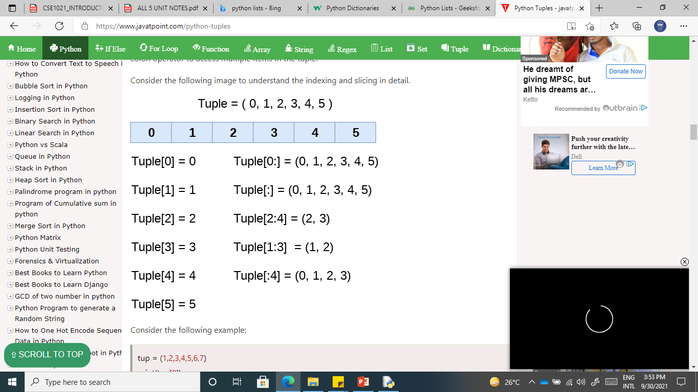

Slide 31
tuple = (1,2,3,4,5,6,7)
#element 1 to end
print(tuple[1:])
#element 0 to 3 element
print(tuple[:4])
#element 1 to 4 element
print(tuple[1:5])
# element 0 to 6 and take step of 2
print(tuple[0:6:2])
(2, 3, 4, 5, 6, 7)
(1, 2, 3, 4)
(1, 2, 3, 4)
(1, 3, 5)

Slide 32
tuple1 = (1, 2, 3, 4, 5)
print(tuple1[-1])
print(tuple1[-4])
print(tuple1[-3:-1])
print(tuple1[:-1])
print(tuple1[-2:])
5
2
(3, 4)
(1, 2, 3, 4)
(4, 5)

Slide 33
Deleting Tuple
Unlike lists, the tuple items cannot be deleted by using the del keyword as tuples are immutable.
To delete an entire tuple, we can use the del keyword with the tuple name
tuple1 = (1, 2, 3, 4, 5, 6)
print(tuple1)
del tuple1[0]
print(tuple1)
del tuple1
print(tuple1)
(1, 2, 3, 4, 5, 6)
Traceback (most recent call last):
File "tuple.py",
line 4, in <module> print(tuple1)
NameError: name 'tuple1' is not defined

Slide 34
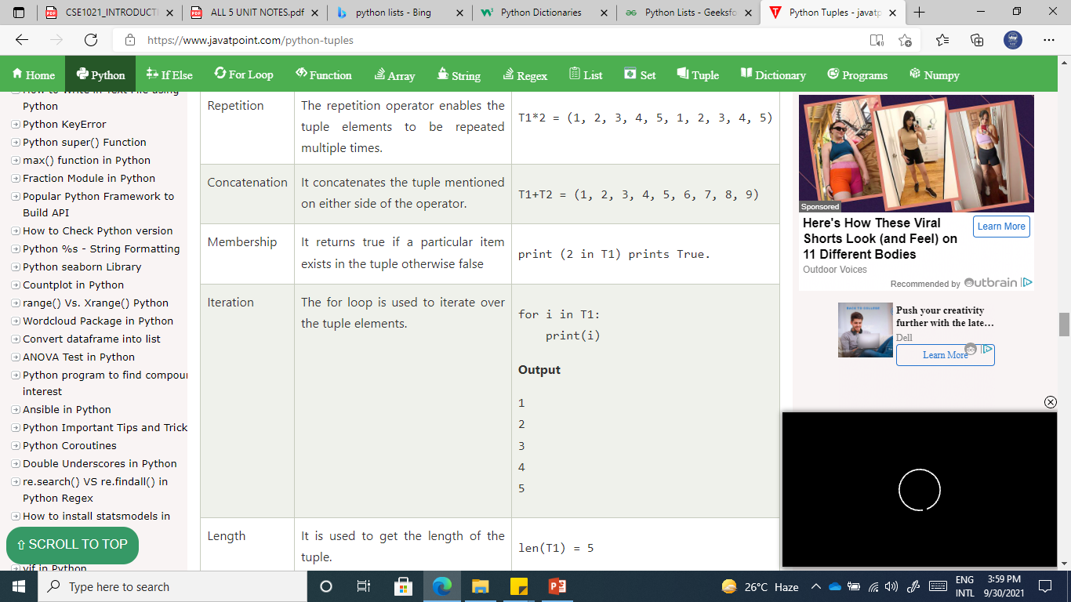
t = (1, 2, 3, 4, 5)
t1 = (6, 7, 8, 9)

Slide 35
